Slide 1

BEATSTAR – MUSIC WEBSITE
A Project Report Submitted By
Priya Garg
(University Roll no. 21002901400107)
Prashant Sharma
(University Roll no. 2100290140105)
Shivam Agrawal
(University Roll no. 2100290140126)
Dhaval Krishna
(University Roll no. 2100290140059)
Submitted in Partial Fulfillment
of the Requirements for the Degree of
MASTER OF COMPUTER APPLICATION
Under the Supervision of
Mrs. Divya Singhal Assistant Professor
Submitted to
DEPARTMENT OF COMPUTER APPLICATIONS
KIET Group of Institutions, Ghaziabad Uttar Pradesh – 201206

Slide 2
DECLARATION
We hereby declare that the project ”BEAT STAR- A MUSIC WEBSITE” submitted to the Department of Computer Application is a record of an original work done by me under the guidance of Mrs.
Divya Singhal (Assistant Professor) Kiet Group of Institutions , Ghaziabad and this project work is submitted in the partial fulfillment of the requirements for the award of the degree of Master of Computer Application. The results embodied in this have not been submitted to any other University or Institute for the award of any degree .
Signature
PRIYA GARG (University Roll no. 2100290140107) PRASHANT SHARMA (University Roll no. 2100290140105) SHIVAM AGRAWAL (University Roll no. 2100290140126) DHAVAL KRISHNA (University Roll no. 2100290140059)
Department of Computer Applications
KIET Group of Institutions, Ghaziabad
Uttar Pradesh – 201206

Slide 3
CERTIFICATE
Certified that PRIYA GARG (University Roll no. 2100290140107), PRASHANT SHARMA (University Roll no. 2100290140105), SHIVAM AGRAWAL (University Roll no. 2100290140126), DHAVAL KRISHNA (University
Roll no. 2100290140059), has carried out the research work presented in this project report entitled “Beat
Star” for the award of Master of Computer Applications from KIET Group of Institutions under my
supervision. The project report embodies results of original work, and studies are carried out by the students themselves and the contents of the thesis do not form the basis for the award of any other degree to the candidates or to anybody else from this or any other University/Institution.
Date:
PRIYA GARG (University Roll no. 2100290140107)
PRASHANT SHARMA (University Roll no. 2100290140105)
SHIVAM AGRAWAL (University Roll no. 2100290140126) DHAVAL KRISHNA (University Roll no. 2100290140059)
This is to certify that the above statement made by the candidate is correct to the best of my knowledge. Date:
Mrs.Divya Singhal
Assistant Professor
Signature of External Examiner
Signature of Internal Examiner
Dr. Arun Kumar Tripathi
Head, Department of Computer Applications KIET Group of Institutions, Ghaziabad

Slide 4
ABSTRACT
The purpose of Beat Star is to automate the existing manual system with the help of computerized equipment and full-fledged computer software, fulfilling their requirements, so that their valuable data/information can be stored for a longer period with easy access and manipulation of the same. The required software and hardware are easily available and easy to work with. Beat Star, as described above, can lead to an error-free, secure, reliable, and fast management system. It can assist the user to concentrate on their other activities rather to concentrate on record keeping. Thus, it will help the organization in better utilization of resources. The organization can maintain computerized records without redundant entries. That means that one need not be distracted by information that is not relevant while being able to reach the information. The aim is to automate its existing manual system with the help of computerized equipment and full-fledged computer software, fulfilling their requirements, so that their valuable data/information can be stored for a longer period with easy access and manipulation of the same. Basically, the project describes how to manage for good performance and better services for the clients
In addition, depending on the user's usage scenario, the music player will also add some modes, such as driving mode and night mode, to allow users to use the application in any situation or environment. Moreover, the music player will have audio trim features, allowing users to trim the best part of their favorite song into phone ringtone or alarm. On the other hand, the existing music players pay less attention to the control of gestures. Therefore, the music player will solve the limitation by adding more gestures and shake the phone feature for media control to make it more user-friendly and humanity.
In a nutshell, the methodology for developing the mp3 music application used in this project is the agile development cycle. The agile development cycle consists of six phases, which is requirements analysis, planning, design, implementation or development, testing, and deployment. Due to the iterative and flexible nature of this approach, it is able to effectively adapt to users with changing requirements .

Slide 5
ACKNOWLEDGMENT
Success in life is never attained single handedly. My deepest gratitude goes to my thesis supervisor, Mrs. Divya Singhal for her guidance, help and encouragement throughout my research work. Their enlightening ideas, comments, and suggestions.
Words are not enough to express my gratitude to Dr. Arun Tripathi, Professor and Head, Department of Computer Applications, for his insightful comments and administrative help at various occasions.
Fortunately, I have many understanding friends, who have helped me a lot on many critical conditions.
Finally, my sincere thanks go to my family members and all those who have directly and indirectly provided me moral support and other kind of help. Without their support, completion of this work would not have been possible in time. They keep my life filled with enjoyment and happiness
PRIYA GARG (University Roll no. 2100290140107)
PRASHANT SHARMA (University Roll no. 2100290140105) SHIVAM AGRAWAL (University Roll no. 2100290140126) DHAVAL KRISHNA (University Roll no. 2100290140059)

Slide 6
 | TABLE OF CONTENTS
Tittle Page Declaration Certificate |  | i ii iii
Abstract Acknowledgements |  | iv v
Table of Contents List of Abbreviations |  | vi-viii ix
List of figures
x
CHAPTER 1: INTRODUCTION
PROJECT DESCRIPTION
PROJECT SCOPE
HARDWARE/ SOFTWARE USED IN THE PROJECT
CHAPTER 2: FEASIBILITY STUDY
TECHNICAL FEASIBILITY
OPERATIONAL FEASIBILITY
ECONOMICAL FEASIBILITY
CHAPTER 3: FLOWCHART/ USE CASE DIAGRAM
FLOWCHART
USE CASE DIAGRAM
CHAPTER 4: WEBSITE DESIGN

Slide 7
SCREENSHOTS
SCREENSHOTS
SCREENSHOTS
CHAPTER 5: CODE
APP.JS
INDEX.CSS
INDEX.JS
CONTROL.JS
DETAILS.JS
PLAYER.JS
MANIFEST.JSON
CHAPTER 6: MODULES OF MUSIC PLAYER CHAPTER 7: TESTING
Test Case-1
Test Case-2
CHAPTER 8: INPUT DATA AND VALIDATION OF THE PROJECT
CHAPTER 9: SOFTWARE REQUIREMENT SPECIFICATION CHAPTER 10: IDENTIFICATION OF NEED
CHAPTER 11: SYSTEM DESIGN
PRIMARY DESIGN PHASE
SECONDARY DESIGN PHASE
CHAPTER 12: USER INTERFACE DESIGN
CHAPTER 13: PRELIMINARY PRODUCT DESCRIPTION CHAPTER 14: BIBLIOGRAPHY

Slide 8
LIST OF ABBREVIATIONS
Apps | Applications
CPU | Central processing unit
IOS | iPhone Operating System
MP3 | MPEG 1 Audio Layer 3
UI | User interface
UTAR | Universiti Tunku Abdul Rahman
VIP | Very Important Person
XML | Full extensible markup language
APK | Android Application Package

Slide 9
CHAPTER-1
INTRODUCTION
The "Beat star" has been developed to override the problems prevailing in the practicing manual system. This software is supported to eliminate and, in some cases, reduce the hardships faced by this existing system. Moreover, this system is designed for the particular need of the company to carry out operations smooth and effective manner. The application is reduced as much as possible to avoid errors while entering the data. It also provides an error message while entering invalid data. No formal knowledge is needed for the user to use this system. Thus, by this all it proves it is user-friendly. Music Player, as described above, can lead to an error-free, secure, reliable, and fast management system. It can assist the user to concentrate on their other activities rather than concentrate on record keeping. Thus, it will help organizations in better utilization of resources. Every organization, whether big or small, has challenges to overcome and manage the information of Album, and Performer. Track, User, Music. Every Music Player has different performer need , therefore we design exclusive employee management systems that are adapted to your managerial requirements. This is designed to assist in strategic planning and will help you ensure that your organization is equipped with the right level of information and details for your future goals.
Also, for those busy executives who are always on the go, our systems come with remote access features, which will allow you to manage your workforce anytime, at all times. These systems will ultimately allow you to better manage resources.
Project Description
The main objective of the Project on Beat Star is to manage the details of the Performer, Album, Album Type, Track, and Music. It manages all the information about Performer, User, Music, and Performer. The project is totally built at the administrative end and thus only the administrator is guaranteed access. The project aims to build an application program to reduce the manual work for managing the Performer, Album, User, and Album Type. It tracks all the details about the Album Type, Track, and Music. Functionalities provided by Beat Star are as follows:
Provides search facilities based on various factors. Such as Performer, Album Type, Track, Music.
Music Player also manages the User details online for Track details, Music details, and Performers.
It tracks all the information of Album, User, Track, etc.
Manage the information on the Album.
Shows the information and description of the Performer, Album Type.
To increase the efficiency of managing the Performer, Album

Slide 10
It deals with monitoring the information and transactions of Track
Manage the information of Performer Editing, adding, and updating of Records is improved which results in proper resource management of Performer data.
Manage the information on Track
Integration of all records of Music.
Project Scope
It may help collect perfect management in detail. The collection will be obvious, simple, and sensible in a very short time. It will help a person to know the management of passed year perfectly and vividly. It also helps in current all works relative to Music Player. It will be also reduced the cost of collecting the management & collection procedure will go on smoothly. Our project aims at Business process automation, i.e., we have tried to computerize various processes of Beat Star.
In the computer system the person must fill the various forms & the number of copies of the forms can be easily generated at a time.
In a computer system, it is not necessary to create the manifest but we can directly print it, which saves our time.
To assist the staff in capturing the effort spent on their respective working areas
To utilize resources in an efficient manner by increasing their productivity through automation.
The system generates types of information that can be used for various purposes.
It satisfies the user’s requirement
Be easy to understand by the user and operator
Be easy to operate
Have a good user interface
Be expandable
Delivered on schedule within the budget
Hardware/ Software used in the project
Hardware Requirement for development –
Input Devices - All basic input devices like keyboard, mouse, etc.
Output Devices - All basic output devices like printer, monitor, etc.
Secondary storage devices -
HDD - 60GB or above.
Back-up - Flash Drive, CD/DVD, cloud storage etc.
Internal components -
RAM - 512 MB (Minimum)
Processor - Intel Pentium 4 Processor or above

Slide 11
Hardware Requirement for User –
Input Devices - All basic input devices like keyboard, mouse, etc.
Output Devices - All basic output devices like printer, monitor, etc.
Software Requirement for development –
System Software –
Operating system (Windows XP or above)
Web Technologies-
HTML
CSS
Bootstrap
JavaScript
Frameworks –
React
Software Requirement for User -
System Software –
Operating system (Windows XP or above)
Web Browser-
Microsoft Edge, Google Chrome

Slide 12
CHAPTER 2 FEASIBILITY STUDY
After doing the project Beat Star, study and analyse all the existing or required functionalities of the system, the next task is to do the feasibility study for the project. All projects are feasible - given unlimited resources and infinite time.
The feasibility study includes consideration of all the possible ways to provide a solution to the given problem. The proposed solution should satisfy all the user requirements and should be flexible enough so that future changes can be easily done based on the future upcoming requirements.
Technical Feasibility
This included the study of function, performance, and constraints that may affect the ability to achieve an acceptable system. For this feasibility study, we studied the complete functionality to be provided in the system, as described in the System Requirement Specification (SRS), and checked if everything was possible using a different type of frontend and backend platforms.
Operational Feasibility
No doubt the proposed system is fully GUI based very user-friendly and all inputs to be taken all self- explanatory even to a layman. Besides, proper training has been conducted to let them know the essence of the system to the users so that they feel comfortable with the new system. As far as our study is concerned the clients are comfortable and happy as the system has cut down their loads and doing.
Economical Feasibility
This is a very important aspect to be considered while developing a project. We decided on the technology based on the minimum possible cost factor.
All hardware and software costs must be borne by the organization.
Overall, we have estimated that the benefits the organization is going to receive from the proposed system will surely overcome the initial costs and the later-on running cost for the system.

Slide 13
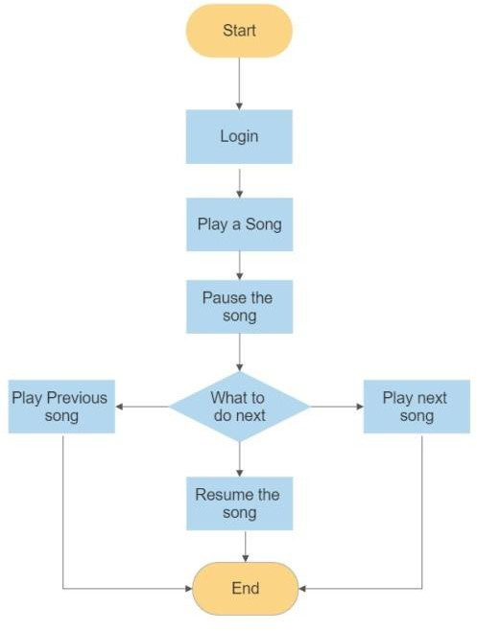
CHAPTER 3 FLOWCHART/ USE CASE DIAGRAM
3.1 Flowchart

Slide 14
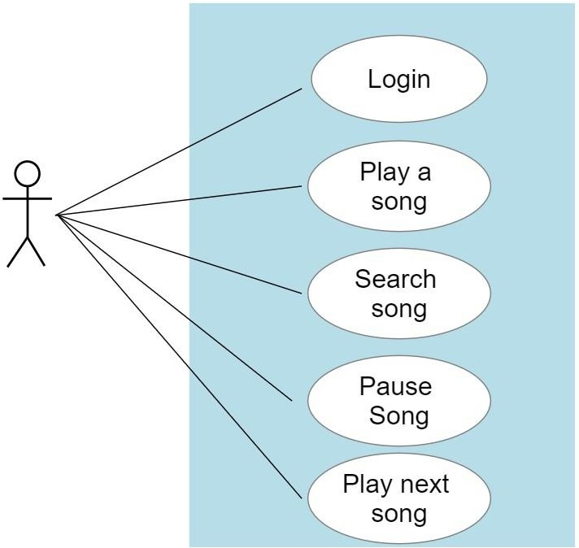
3.2 Use case Diagram

Slide 15
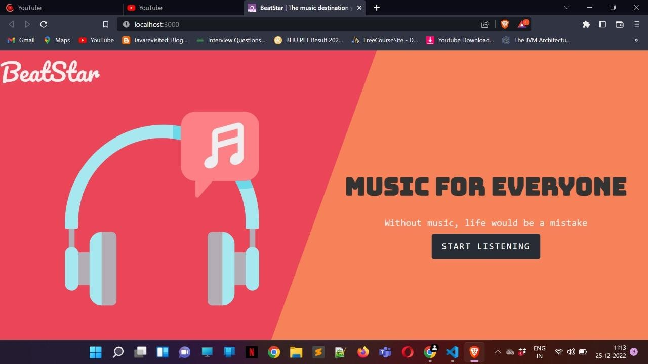
CHAPTER 4
WEBSITE DESIGN
4.1 Screenshots
Fig 4.1

Slide 16
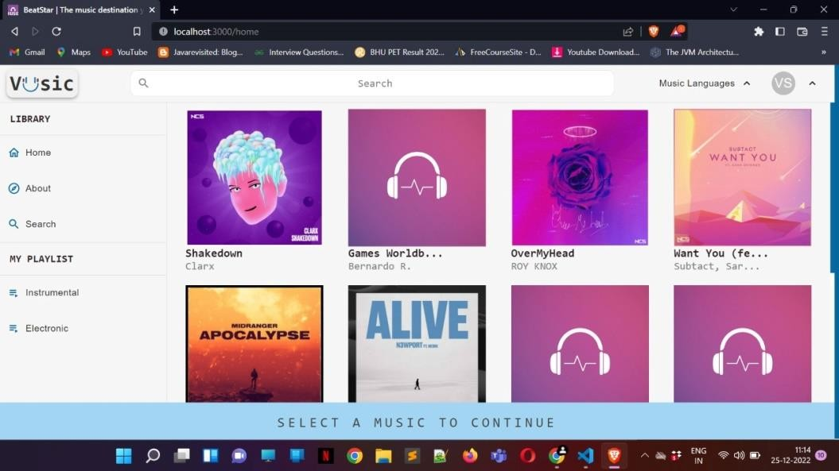
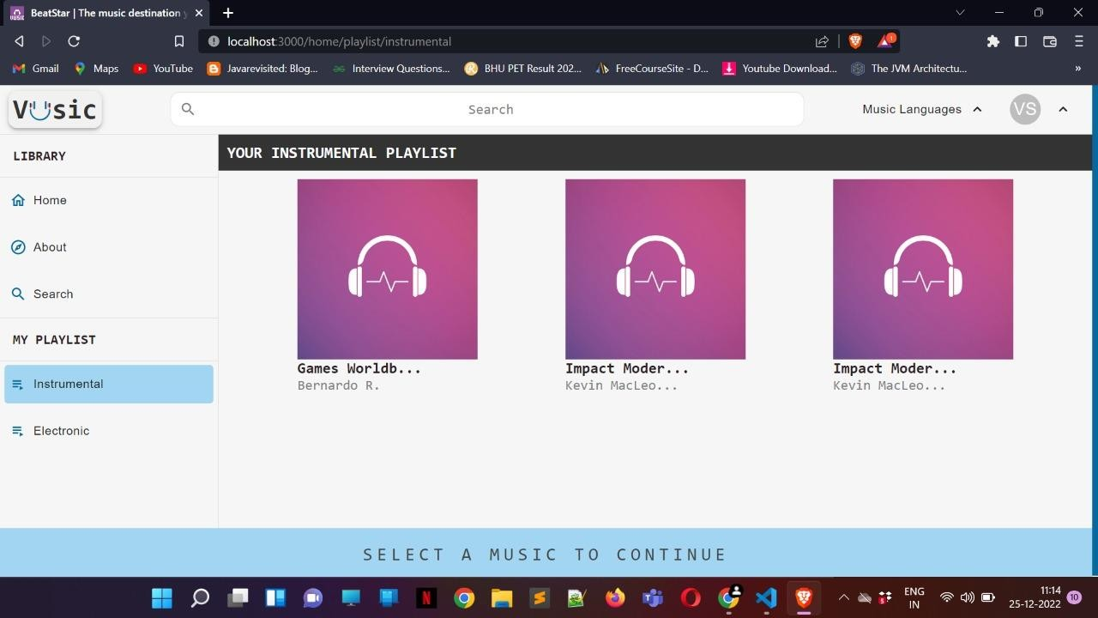
Fig 4.2
Fig 4.3

Slide 17

Fig 4.4

Slide 18
CHAPTER 5 CODE
export const setPlaylist = (playlist) => { return {
type:"SET_PLAYLIST",
payload:playlist
};
};
export const setCurrentPlaying = (curr_music) => { return {
type: "SET_CURR_PLAYING",
payload: curr_music
};
}
export const setBannerOpen = (isOpen) => { return {
type:"SET_BANNER_OPEN",
payload:isOpen
};
};
export const increaseTimesPlayed = (id) => { return {
type:"INC_TIMES_PLAYED",
payload: id
};
};
export const setSearch = (searchQuery) => { return {
type:"SET_SEARCH_QUERY",
payload: searchQuery

Slide 19
};
};
export const setMusicLang = (langList) => { return {
type:"SET_MUSIC_LIST",
payload: langList
};
};
import React from "react";
export const themes = { light: {
theme: "#07689f", subTheme: "#a2d5f2",
component:{ backgroundColor: "#f6f6f6", color: "#2b2024",
},
button:{ onHover:{
backgroundColor:"#a2d5f2", color:"#191919"
},
contained:{
backgroundColor: "#07689f", color:"#fafafa"
},
outlined:{ backgroundColor:"transparent", color:"#191919"
}
},
volume:{

Slide 20
color:"#07689f"
}
},
dark: {
theme:"#4ecca3", subTheme: "#a2d5f2", component:{
backgroundColor: "#232931", color: "#eeeeee",
},
button:{ onHover:{
backgroundColor:"#a2d5f2", color:"#fafafa"
},
contained:{
backgroundColor: "#07689f", color:"black"
},
outlined:{
backgroundColor:"transparent", color:"#fafafa"
}
},
volume:{ color:"#07689f"
}
}
};
export const ThemeContext = React.createContext( themes.light
);

Slide 21
/*
export const ThemeProvider = (props) => {
const [theme,setTheme] = useState("light"); return (
<ThemeContext.Provider value={[theme,setTheme]}>
{props.children}
</ThemeContext.Provider>
);
}*/
[11:08 am, 25/12/2022] Prashant Dost 1: import React, {useEffect} from "react"; import './App.scss';
import Home from "../components/Pages/Home";
import {BrowserRouter as Router, Route, Switch} from 'react-router-dom'; import Login from "../components/Pages/Login";
import {ThemeContext, themes} from "../api/Theme"; import musicDB from "../db/music";
import {useDispatch, useSelector} from "react-redux"; import {setPlaylist} from "../actions/actions";
const App = () => {
const {language} = useSelector(state => state.musicReducer); const dispatch = useDispatch();
useEffect(()=>{
if (language === null || language.includes("any")){ dispatch(setPlaylist(musicDB))
}
else if (language.includes('hindi')){ alert("No hindi tracks available")
} else {
let x = musicDB.filter((item)=>(
item.lang && language.includes(item.lang.toLowerCase())

Slide 22
))
dispatch(setPlaylist(x))
}
},[dispatch, language]);
return (
<ThemeContext.Provider value={themes.light}>
<>
<Router>
<Switch>
<Route path="/" exact component={Login}/>
<Route path="/home" component={Home}/>
</Switch>
</Router>
</>\
</ThemeContext.Provider>
);
}
export default App;
* {
box-sizing: border-box;
}
body {
font-family: Consolas, sans-serif; padding: 0;
margin: 0;
background-color: #F1F1F1;
}
h1, h2, h3, h4, h5, h6, p { margin: 0;
padding: 0;

Slide 23
}
a {
text-decoration: none;
}
/*# sourceMappingURL=index.scss.map */ "node_modules/@babel/plugin-transform-modules-umd": {
"version": "7.18.6",
"resolved": "https://registry.npmjs.org/@babel/plugin-transform-modules-umd/-/plugin-transform- modules-umd-7.18.6.tgz",
"integrity": "sha512- dcegErExVeXcRqNtkRU/z8WlBLnvD4MRnHgNs3MytRO1Mn1sHRyhbcpYbVMGclAqOjdW+9cfkdZno 9dFdfKLfQ==",
"dependencies": {
"@babel/helper-module-transforms": "^7.18.6", "@babel/helper-plugin-utils": "^7.18.6"
},
"engines": { "node": ">=6.9.0"
},
"peerDependencies": { "@babel/core": "^7.0.0-0"
}
},
"node_modules/@babel/plugin-transform-named-capturing-groups-regex": { "version": "7.19.1",
"resolved": "https://registry.npmjs.org/@babel/plugin-transform-named-capturing-groups-regex/-
/plugin-transform-named-capturing-groups-regex-7.19.1.tgz",
"integrity": "sha512- oWk9l9WItWBQYS4FgXD4Uyy5kq898lvkXpXQxoJEY1RnvPk4R/Dvu2ebXU9q8lP+rlMwUQTFf2Ok6d 78ODa0kw==",
"dependencies": {
"@babel/helper-create-regexp-features-plugin": "^7.19.0", "@babel/helper-plugin-utils": "^7.19.0"
},

Slide 24
"engines": { "node": ">=6.9.0"
},
"peerDependencies": { "@babel/core": "^7.0.0"
}
},
"node_modules/@babel/plugin-transform-new-target": { "version": "7.18.6",
"resolved": "https://registry.npmjs.org/@babel/plugin-transform-new-target/-/plugin-transform-new- target-7.18.6.tgz",
"integrity": "sha512- DjwFA/9Iu3Z+vrAn+8pBUGcjhxKguSMlsFqeCKbhb9BAV756v0krzVK04CRDi/4aqmk8BsHb4a/gFcaA5j oXRw==",
"dependencies": {
"@babel/helper-plugin-utils": "^7.18.6”
},
"engines": { "node": ">=6.9.0"
},
"peerDependencies": { "@babel/core": "^7.0.0-0"
}
},
"node_modules/@babel/plugin-transform-object-super": { "version": "7.18.6",
"resolved": "https://registry.npmjs.org/@babel/plugin-transform-object-super/-/plugin-transform-object- super-7.18.6.tgz",
"integrity": "sha512- uvGz6zk+pZoS1aTZrOvrbj6Pp/kK2mp45t2B+bTDre2UgsZZ8EZLSJtUg7m/no0zOJUWgFONpB7Zv9W2t SaFlA==",
"dependencies": {
"@babel/helper-plugin-utils": "^7.18.6", "@babel/helper-replace-supers": "^7.18.6"
},
"engines": {

Slide 25
"node": ">=6.9.0"
},
"peerDependencies": { "@babel/core": "^7.0.0-0"
}
},
"node_modules/@babel/plugin-transform-parameters": { "version": "7.18.8",
"resolved": "https://registry.npmjs.org/@babel/plugin-transform-parameters/-/plugin-transform- parameters-7.18.8.tgz",
"integrity": "sha512- ivfbE3X2Ss+Fj8nnXvKJS6sjRG4gzwPMsP+taZC+ZzEGjAYlvENixmt1sZ5Ca6tWls+BlKSGKPJ6OOXvX CbkFg==",
"dependencies": {
"@babel/helper-plugin-utils": "^7.18.6"
},
"engines": { "node": ">=6.9.0"
},
"peerDependencies": { "@babel/core": "^7.0.0-0"
}
},
"node_modules/@babel/plugin-transform-property-literals": { "version": "7.18.6",
"resolved": "https://registry.npmjs.org/@babel/plugin-transform-property-literals/-/plugin-transform- property-literals-7.18.6.tgz",
"integrity": "sha512- cYcs6qlgafTud3PAzrrRNbQtfpQ8+y/+M5tKmksS9+M1ckbH6kzY8MrexEM9mcA6JDsukE19iIRvAyYl46 3sMg==",
"dependencies": {
"@babel/helper-plugin-utils": "^7.18.6"
},
"engines": { "node": ">=6.9.0"
},

Slide 26
"peerDependencies": { "@babel/core": "^7.0.0-0"
}
},
"node_modules/@babel/plugin-transform-react-constant-elements": { "version": "7.18.12",
"resolved": "https://registry.npmjs.org/@babel/plugin-transform-react-constant-elements/-/plugin- transform-react-constant-elements-7.18.12.tgz",
"integrity": "sha512- Q99U9/ttiu+LMnRU8psd23HhvwXmKWDQIpocm0JKaICcZHnw+mdQbHm6xnSy7dOl8I5PELakYtNBu bNQlBXbZw==",
"dependencies": {
"@babel/helper-plugin-utils": "^7.18.9"
},
"engines": { "node": ">=6.9.0"
},
"peerDependencies": { "@babel/core": "^7.0.0-0"
}
},
"node_modules/@babel/plugin-transform-react-display-name": { "version": "7.18.6",
"resolved": "https://registry.npmjs.org/@babel/plugin-transform-react-display-name/-/plugin-transform- react-display-name-7.18.6.tgz",
"integrity": "sha512- TV4sQ+T013n61uMoygyMRm+xf04Bd5oqFpv2jAEQwSZ8NwQA7zeRPg1LMVg2PWi3zWBz+CLKD+v 5bcpZ/BS0aA==",
"dependencies": {
"@babel/helper-plugin-utils": "^7.18.6"
},
"engines": { "node": ">=6.9.0"
},
"peerDependencies": { "@babel/core": "^7.0.0-0"

Slide 27
}
},
"node_modules/@babel/plugin-transform-react-jsx": { "version": "7.19.0",
"resolved": "https://registry.npmjs.org/@babel/plugin-transform-react-jsx/-/plugin-transform-react-jsx- 7.19.0.tgz",
"integrity": "sha512- UVEvX3tXie3Szm3emi1+G63jyw1w5IcMY0FSKM+CRnKRI5Mr1YbCNgsSTwoTwKphQEG9P+QqmuR FneJPZuHNhg==",
"dependencies": {
"@babel/helper-annotate-as-pure": "^7.18.6", "@babel/helper-module-imports": "^7.18.6", "@babel/helper-plugin-utils": "^7.19.0", "@babel/plugin-syntax-jsx": "^7.18.6", "@babel/types": "^7.19.0"
},
"engines": { "node": ">=6.9.0"
},
"peerDependencies": { "@babel/core": "^7.0.0-0"
}
},
"node_modules/@babel/plugin-transform-react-jsx-development": { "version": "7.18.6",
"resolved": "https://registry.npmjs.org/@babel/plugin-transform-react-jsx-development/-/plugin- transform-react-jsx-development-7.18.6.tgz",
"integrity": "sha512- SA6HEjwYFKF7WDjWcMcMGUimmw/nhNRDWxr+KaLSCrkD/LMDBvWRmHAYgE1HDeF8KUuI8O Au+RT6EOtKxSW2qA==",
"dependencies": {
"@babel/plugin-transform-react-jsx": "^7.18.6"
},
"engines": { "node": ">=6.9.0"
},

Slide 28
"peerDependencies": { "@babel/core": "^7.0.0-0"
}
},
"node_modules/@babel/plugin-transform-react-pure-annotations": { "version": "7.18.6",
"resolved": "https://registry.npmjs.org/@babel/plugin-transform-react-pure-annotations/-/plugin- transform-react-pure-annotations-7.18.6.tgz",
"integrity": "sha512- I8VfEPg9r2TRDdvnHgPepTKvuRomzA8+u+nhY7qSI1fR2hRNebasZEETLyM5mAUr0Ku56OkXJ0I7NH JnO6cJiQ==",
"dependencies": {
"@babel/helper-annotate-as-pure": "^7.18.6", "@babel/helper-plugin-utils": "^7.18.6"
},
"engines": { "node": ">=6.9.0"
},
"peerDependencies": { "@babel/core": "^7.0.0-0"
}
},
"node_modules/@babel/plugin-transform-regenerator": { "version": "7.18.6",
"resolved": "https://registry.npmjs.org/@babel/plugin-transform-regenerator/-/plugin-transform- regenerator-7.18.6.tgz",
"integrity": "sha512- poqRI2+qiSdeldcz4wTSTXBRryoq3Gc70ye7m7UD5Ww0nE29IXqMl6r7Nd15WBgRd74vloEMlShtH6CK xVzfmQ==",
"dependencies": {
"@babel/helper-plugin-utils": "^7.18.6", "regenerator-transform": "^0.15.0"
},
"engines": { "node": ">=6.9.0"
},

Slide 29
"peerDependencies": { "@babel/core": "^7.0.0-0"
}
},
"node_modules/@babel/plugin-transform-reserved-words": { "version": "7.18.6",
"resolved": "https://registry.npmjs.org/@babel/plugin-transform-reserved-words/-/plugin-transform- reserved-words-7.18.6.tgz",
"integrity": "sha512- oX/4MyMoypzHjFrT1CdivfKZ+XvIPMFXwwxHp/r0Ddy2Vuomt4HDFGmft1TAY2yiTKiNSsh3kjBAzc M8kSdsjA==",
"dependencies": {
"@babel/helper-plugin-utils": "^7.18.6"
},
"engines": { "node": ">=6.9.0"
},
"peerDependencies": { "@babel/core": "^7.0.0-0"
}
},
"node_modules/@babel/plugin-transform-runtime": { "version": "7.19.1",
"resolved": "https://registry.npmjs.org/@babel/plugin-transform-runtime/-/plugin-transform-runtime- 7.19.1.tgz",
"integrity": "sha512- 2nJjTUFIzBMP/f/miLxEK9vxwW/KUXsdvN4sR//TmuDhe6yU2h57WmIOE12Gng3MDP/xpjUV/ToZRdc f8Yj4fA==",
"dependencies": {
"@babel/helper-module-imports": "^7.18.6", "@babel/helper-plugin-utils": "^7.19.0",
"babel-plugin-polyfill-corejs2": "^0.3.3", "babel-plugin-polyfill-corejs3": "^0.6.0", "babel-plugin-polyfill-regenerator": "^0.4.1", "semver": "^6.3.0"
},

Slide 30
"engines": { "node": ">=6.9.0"
},
"peerDependencies": { "@babel/core": "^7.0.0-0"
}
},
"node_modules/@babel/plugin-transform-runtime/node_modules/semver": { "version": "6.3.0",
"resolved": "https://registry.npmjs.org/semver/-/semver-6.3.0.tgz", "integrity": "sha512-
b39TBaTSfV6yBrapU89p5fKekE2m/NwnDocOVruQFS1/veMgdzuPcnOM34M6CwxW8jH/lxEa5rBoDeU
wu5HHTw==",
"bin": {
"semver": "bin/semver.js"
}
},
"node_modules/@babel/plugin-transform-shorthand-properties": { "version": "7.18.6",
"resolved": "https://registry.npmjs.org/@babel/plugin-transform-shorthand-properties/-/plugin- transform-shorthand-properties-7.18.6.tgz",
"integrity": "sha512- eCLXXJqv8okzg86ywZJbRn19YJHU4XUa55oz2wbHhaQVn/MM+XhukiT7SYqp/7o00dg52Rj51Ny+Ecw 4oyoygw==",
"dependencies": {
"@babel/helper-plugin-utils": "^7.18.6"
},
"engines": { "node": ">=6.9.0"
},
"peerDependencies": { "@babel/core": "^7.0.0-0"
}
},
"node_modules/@babel/plugin-transform-spread": {

Slide 31
"version": "7.19.0",
"resolved": "https://registry.npmjs.org/@babel/plugin-transform-spread/-/plugin-transform-spread- 7.19.0.tgz",
"integrity": "sha512- RsuMk7j6n+r752EtzyScnWkQyuJdli6LdO5Klv8Yx0OfPVTcQkIUfS8clx5e9yHXzlnhOZF3CbQ8C2uP5j0 74w==",
"dependencies": {
"@babel/helper-plugin-utils": "^7.19.0",
"@babel/helper-skip-transparent-expression-wrappers": "^7.18.9"
},
"engines": { "node": ">=6.9.0"
},
"peerDependencies": { "@babel/core": "^7.0.0-0"
}
},
"node_modules/@babel/plugin-transform-sticky-regex": { "version": "7.18.6",
"resolved": "https://registry.npmjs.org/@babel/plugin-transform-sticky-regex/-/plugin-transform-sticky- regex-7.18.6.tgz",
"integrity": "sha512- kfiDrDQ+PBsQDO85yj1icueWMfGfJFKN1KCkndygtu/C9+XUfydLC8Iv5UYJqRwy4zk8EcplRxEOeLyjq 1gm6Q==",
"dependencies": {
"@babel/helper-plugin-utils": "^7.18.6"
},
"engines": { "node": ">=6.9.0"
},
"peerDependencies": { "@babel/core": "^7.0.0-0"
}
},
"node_modules/@babel/plugin-transform-template-literals": { "version": "7.18.9",

Slide 32
"resolved": "https://registry.npmjs.org/@babel/plugin-transform-template-literals/-/plugin-transform- template-literals-7.18.9.tgz",
"integrity": "sha512- S8cOWfT82gTezpYOiVaGHrCbhlHgKhQt8XH5ES46P2XWmX92yisoZywf5km75wv5sYcXDUCLMmM xOLCtthDgMA==",
"dependencies": {
"@babel/helper-plugin-utils": "^7.18.9"
},
"engines": { "node": ">=6.9.0"
},
"peerDependencies": { "@babel/core": "^7.0.0-0"
}
},
"node_modules/@babel/plugin-transform-typeof-symbol": { "version": "7.18.9",
"resolved": "https://registry.npmjs.org/@babel/plugin-transform-typeof-symbol/-/plugin-transform- typeof-symbol-7.18.9.tgz",
"integrity": "sha512- SRfwTtF11G2aemAZWivL7PD+C9z52v9EvMqH9BuYbabyPuKUvSWks3oCg6041pT925L4zVFqaVBeE CwsmlguEw==",
"dependencies": {
"@babel/helper-plugin-utils": "^7.18.9"
},
"engines": { "node": ">=6.9.0"
},
"peerDependencies": { "@babel/core": "^7.0.0-0"
}
},
"node_modules/@babel/plugin-transform-typescript": { "version": "7.19.3",
"resolved": "https://registry.npmjs.org/@babel/plugin-transform-typescript/-/plugin-transform- typescript-7.19.3.tgz",

Slide 33
"integrity": "sha512- z6fnuK9ve9u/0X0rRvI9MY0xg+DOUaABDYOe+/SQTxtlptaBB/V9JIUxJn6xp3lMBeb9qe8xSFmHU35oZ DXD+w==",
"dependencies": {
"@babel/helper-create-class-features-plugin": "^7.19.0", "@babel/helper-plugin-utils": "^7.19.0", "@babel/plugin-syntax-typescript": "^7.18.6"
},
"engines": { "node": ">=6.9.0"
},
"peerDependencies": { "@babel/core": "^7.0.0-0"
}
},
"node_modules/@babel/plugin-transform-unicode-escapes": { "version": "7.18.10",
"resolved": "https://registry.npmjs.org/@babel/plugin-transform-unicode-escapes/-/plugin-transform- unicode-escapes-7.18.10.tgz",
"integrity": "sha512- kKAdAI+YzPgGY/ftStBFXTI1LZFju38rYThnfMykS+IXy8BVx+res7s2fxf1l8I35DV2T97ezo6+SGrXz6B 3iQ==",
"dependencies": {
"@babel/helper-plugin-utils": "^7.18.9"
},
"engines": { "node": ">=6.9.0"
},
"peerDependencies": { "@babel/core": "^7.0.0-0"
}
},
"node_modules/@babel/plugin-transform-unicode-regex": { "version": "7.18.6",
"resolved": "https://registry.npmjs.org/@babel/plugin-transform-unicode-regex/-/plugin-transform- unicode-regex-7.18.6.tgz",

Slide 34
"integrity": "sha512- gE7A6Lt7YLnNOL3Pb9BNeZvi+d8l7tcRrG4+pwJjK9hD2xX4mEvjlQW60G9EEmfXVYRPv9VRQcyegI VHCql/AA==",
"dependencies": {
"@babel/helper-create-regexp-features-plugin": "^7.18.6", "@babel/helper-plugin-utils": "^7.18.6"
},
"engines": { "node": ">=6.9.0"
},
"peerDependencies": { "@babel/core": "^7.0.0-0"
}
},
"node_modules/@babel/preset-env": { "version": "7.19.3",
"resolved": "https://registry.npmjs.org/@babel/preset-env/-/preset-env-7.19.3.tgz", "integrity": "sha512-
ziye1OTc9dGFOAXSWKUqQblYHNlBOaDl8wzqf2iKXJAltYiR3hKHUKmkt+S9PppW7RQpq4fFCrwwp
IDj/f5P4w==",
"dependencies": {
"@babel/compat-data": "^7.19.3", "@babel/helper-compilation-targets": "^7.19.3", "@babel/helper-plugin-utils": "^7.19.0", "@babel/helper-validator-option": "^7.18.6",
"@babel/plugin-bugfix-safari-id-destructuring-collision-in-function-expression": "^7.18.6",
"@babel/plugin-bugfix-v8-spread-parameters-in-optional-chaining": "^7.18.9", "@babel/plugin-proposal-async-generator-functions": "^7.19.1", "@babel/plugin-proposal-class-properties": "^7.18.6",
"@babel/plugin-proposal-class-static-block": "^7.18.6", "@babel/plugin-proposal-dynamic-import": "^7.18.6", "@babel/plugin-proposal-export-namespace-from": "^7.18.9", "@babel/plugin-proposal-json-strings": "^7.18.6",
"@babel/plugin-proposal-logical-assignment-operators": "^7.18.9", "@babel/plugin-proposal-nullish-coalescing-operator": "^7.18.6",

Slide 35
"@babel/plugin-proposal-numeric-separator": "^7.18.6", "@babel/plugin-proposal-object-rest-spread": "^7.18.9", "@babel/plugin-proposal-optional-catch-binding": "^7.18.6", "@babel/plugin-proposal-optional-chaining": "^7.18.9", "@babel/plugin-proposal-private-methods": "^7.18.6", "@babel/plugin-proposal-private-property-in-object": "^7.18.6", "@babel/plugin-proposal-unicode-property-regex": "^7.18.6", "@babel/plugin-syntax-async-generators": "^7.8.4", "@babel/plugin-syntax-class-properties": "^7.12.13", "@babel/plugin-syntax-class-static-block": "^7.14.5", "@babel/plugin-syntax-dynamic-import": "^7.8.3", "@babel/plugin-syntax-export-namespace-from": "^7.8.3", "@babel/plugin-syntax-import-assertions": "^7.18.6", "@babel/plugin-syntax-json-strings": "^7.8.3",
"@babel/plugin-syntax-logical-assignment-operators": "^7.10.4",
"@babel/plugin-syntax-nullish-coalescing-operator": "^7.8.3", "@babel/plugin-syntax-numeric-separator": "^7.10.4", "@babel/plugin-syntax-object-rest-spread": "^7.8.3", "@babel/plugin-syntax-optional-catch-binding": "^7.8.3", "@babel/plugin-syntax-optional-chaining": "^7.8.3", "@babel/plugin-syntax-private-property-in-object": "^7.14.5", "@babel/plugin-syntax-top-level-await": "^7.14.5", "@babel/plugin-transform-arrow-functions": "^7.18.6", "@babel/plugin-transform-async-to-generator": "^7.18.6", "@babel/plugin-transform-block-scoped-functions": "^7.18.6", "@babel/plugin-transform-block-scoping": "^7.18.9", "@babel/plugin-transform-classes": "^7.19.0",
"@babel/plugin-transform-computed-properties": "^7.18.9",
"@babel/plugin-transform-destructuring": "^7.18.13", "@babel/plugin-transform-dotall-regex": "^7.18.6", "@babel/plugin-transform-duplicate-keys": "^7.18.9", "@babel/plugin-transform-exponentiation-operator": "^7.18.6", "@babel/plugin-transform-for-of": "^7.18.8",
"@babel/plugin-transform-function-name": "^7.18.9",

Slide 36
"@babel/plugin-transform-literals": "^7.18.9",
"@babel/plugin-transform-member-expression-literals": "^7.18.6",
"@babel/plugin-transform-modules-amd": "^7.18.6", "@babel/plugin-transform-modules-commonjs": "^7.18.6", "@babel/plugin-transform-modules-systemjs": "^7.19.0", "@babel/plugin-transform-modules-umd": "^7.18.6",
"@babel/plugin-transform-named-capturing-groups-regex": "^7.19.1", "@babel/plugin-transform-new-target": "^7.18.6",
"@babel/plugin-transform-object-super": "^7.18.6", "@babel/plugin-transform-parameters": "^7.18.8",
"@babel/plugin-transform-property-literals": "^7.18.6", "@babel/plugin-transform-regenerator": "^7.18.6",
"@babel/plugin-transform-reserved-words": "^7.18.6", "@babel/plugin-transform-shorthand-properties": "^7.18.6", "@babel/plugin-transform-spread": "^7.19.0",
"@babel/plugin-transform-sticky-regex": "^7.18.6", "@babel/plugin-transform-template-literals": "^7.18.9", "@babel/plugin-transform-typeof-symbol": "^7.18.9",
"@babel/plugin-transform-unicode-escapes": "^7.18.10", "@babel/plugin-transform-unicode-regex": "^7.18.6",
"@babel/preset-modules": "^0.1.5", "@babel/types": "^7.19.3",
"babel-plugin-polyfill-corejs2": "^0.3.3",
"babel-plugin-polyfill-corejs3": "^0.6.0", "babel-plugin-polyfill-regenerator": "^0.4.1", "core-js-compat": "^3.25.1",
"semver": "^6.3.0"
},
"engines": { "node": ">=6.9.0"
},
"peerDependencies": { "@babel/core": "^7.0.0-0"
}

Slide 37
},
"node_modules/@babel/preset-env/node_modules/semver": { "version": "6.3.0",
"resolved": "https://registry.npmjs.org/semver/-/semver-6.3.0.tgz",
"integrity": "sha512- b39TBaTSfV6yBrapU89p5fKekE2m/NwnDocOVruQFS1/veMgdzuPcnOM34M6CwxW8jH/lxEa5rBoDeU wu5HHTw==",
"bin": {
"semver": "bin/semver.js"
}
},
"node_modules/@babel/preset-modules": { "version": "0.1.5",
"resolved": "https://registry.npmjs.org/@babel/preset-modules/-/preset-modules-0.1.5.tgz",
"integrity": "sha512- A57th6YRG7oR3cq/yt/Y84MvGgE0eJG2F1JLhKuyG+jFxEgrd/HAMJatiFtmOiZurz+0DkrvbheCLaV5f2Jf jA==",
"dependencies": {
"@babel/helper-plugin-utils": "^7.0.0",
"@babel/plugin-proposal-unicode-property-regex": "^7.4.4",
"@babel/plugin-transform-dotall-regex": "^7.4.4", "@babel/types": "^7.4.4",
"esutils": "^2.0.2"
},
"peerDependencies": { "@babel/core": "^7.0.0-0"
}
},
"node_modules/@babel/preset-react": { "version": "7.18.6",
"resolved": "https://registry.npmjs.org/@babel/preset-react/-/preset-react-7.18.6.tgz", "integrity": "sha512-
zXr6atUmyYdiWRVLOZahakYmOBHtWc2WGCkP8PYTgZi0iJXDY2CN180TdrIW4OGOAdLc7TifzDIv
tx6izaRIzg==",
"dependencies": {

Slide 38
"@babel/helper-plugin-utils": "^7.18.6", "@babel/helper-validator-option": "^7.18.6",
"@babel/plugin-transform-react-display-name": "^7.18.6", "@babel/plugin-transform-react-jsx": "^7.18.6", "@babel/plugin-transform-react-jsx-development": "^7.18.6", "@babel/plugin-transform-react-pure-annotations": "^7.18.6"
},
"engines": { "node": ">=6.9.0"
},
"peerDependencies": { "@babel/core": "^7.0.0-0"
}
},
"node_modules/@babel/preset-typescript": { "version": "7.18.6",
"resolved": "https://registry.npmjs.org/@babel/preset-typescript/-/preset-typescript-7.18.6.tgz",
"integrity": "sha512- s9ik86kXBAnD760aybBucdpnLsAt0jK1xqJn2juOn9lkOvSHV60os5hxoVJsPzMQxvnUJFAlkont2DvvaYE BtQ==",
"dependencies": {
"@babel/helper-plugin-utils": "^7.18.6",
"@babel/helper-validator-option": "^7.18.6", "@babel/plugin-transform-typescript": "^7.18.6"
},
"engines": { "node": ">=6.9.0"
},
"peerDependencies": { "@babel/core": "^7.0.0-0"
}
},
"node_modules/@babel/runtime": { "version": "7.19.0",

Slide 39
"resolved": "https://registry.npmjs.org/@babel/runtime/-/runtime-7.19.0.tgz", "integrity": "sha512-
eR8Lo9hnDS7tqkO7NsV+mKvCmv5boaXFSZ70DnfhcgiEne8hv9oCEd36Klw74EtizEqLsy4YnW8UWwp BVolHZA==",
"dependencies": {
"regenerator-runtime": "^0.13.4"
},
"engines": { "node": ">=6.9.0"
}
},
"node_modules/@babel/runtime-corejs3": { "version": "7.19.1",
"resolved": "https://registry.npmjs.org/@babel/runtime-corejs3/-/runtime-corejs3-7.19.1. tgz",
"integrity": "sha512- j2vJGnkopRzH+ykJ8h68wrHnEUmtK//E723jjixiAl/PPf6FhqY/vYRcMVlNydRKQjQsTsYEjpx+DZMIvnG k/g==",
"dependencies": {
"core-js-pure": "^3.25.1", "regenerator-runtime": "^0.13.4"
},
"engines": { "node": ">=6.9.0"
}
},
"node_modules/@babel/template": { "version": "7.18.10",
"resolved": "https://registry.npmjs.org/@babel/template/-/template-7.18.10.tgz", "integrity": "sha512-
TI+rCtooWHr3QJ27kJxfjutghu44DLnasDMwpDqCXVTal9RLp3RSYNh4NdBrRP2cQAoG9A8juOQl6P6
oZG4JxA==",
"dependencies": {
"@babel/code-frame": "^7.18.6", "@babel/parser": "^7.18.10", "@babel/types": "^7.18.10"

Slide 40
},
"engines": { "node": ">=6.9.0"
}
},
"node_modules/@babel/traverse": { "version": "7.19.3",
"resolved": "https://registry.npmjs.org/@babel/traverse/-/traverse-7.19.3.tgz", "integrity": "sha512-
qh5yf6149zhq2sgIXmwjnsvmnNQC2iw70UFjp4olxucKrWd/dvlUsBI88VSLUsnMNF7/vnOiA+nk1+yLoC qROQ==",
"dependencies": {
"@babel/code-frame": "^7.18.6", "@babel/generator": "^7.19.3",
"@babel/helper-environment-visitor": "^7.18.9", "@babel/helper-function-name": "^7.19.0", "@babel/helper-hoist-variables": "^7.18.6", "@babel/helper-split-export-declaration": "^7.18.6", "@babel/parser": "^7.19.3",
"@babel/types": "^7.19.3",
"debug": "^4.1.0",
"globals": "^11.1.0"
},
"engines": { "node": ">=6.9.0"
}
},
"node_modules/@babel/types": { "version": "7.19.3",
"resolved": "https://registry.npmjs.org/@babel/types/-/types-7.19.3.tgz", "integrity": "sha512-
hGCaQzIY22DJlDh9CH7NOxgKkFjBk0Cw9xDO1Xmh2151ti7wiGfQ3LauXzL4HP1fmFlTX6XjpRETTp
Ucv7wQLw==",
"dependencies": {
"@babel/helper-string-parser": "^7.18.10",

Slide 41
"@babel/helper-validator-identifier": "^7.19.1", "to-fast-properties": "^2.0.0"
},
"engines": { "node": ">=6.9.0"
}
},
"node_modules/@bcoe/v8-coverage": { "version": "0.2.3",
"resolved": "https://registry.npmjs.org/@bcoe/v8-coverage/-/v8-coverage-0.2.3.tgz", "integrity": "sha512-
0hYQ8SB4Db5zvZB4axdMHGwEaQjkZzFjQiN9LVYvIFB2nSUHW9tYpxWriPrWDASIxiaXax83REcLx
uSdnGPZtw=="
},
"node_modules/@csstools/normalize.css": { "version": "12.0.0",
"resolved": "https://registry.npmjs.org/@csstools/normalize.css/-/normalize.css-12.0.0.tgz", "integrity": "sha512-
M0qqxAcwCsIVfpFQSlGN5XjXWu8l5JDZN+fPt1LeW5SZexQTgnaEvgXAY+CeygRw0EeppWHi12JxE
SWiWrB0Sg=="
},
"node_modules/@csstools/postcss-cascade-layers": { "version": "1.1.1",
"resolved": "https://registry.npmjs.org/@csstools/postcss-cascade-layers/-/postcss-cascade-layers- 1.1.1.tgz",
"integrity": "sha512-
+KdYrpKC5TgomQr2DlZF4lDEpHcoxnj5IGddYYfBWJAKfj1JtuHUIqMa+E1pJJ+z3kvDViWMqyqPlG4J a7amQA==",
"dependencies": {
"@csstools/selector-specificity": "^2.0.2", "postcss-selector-parser": "^6.0.10"
},
"engines": {
"node": "^12 || ^14 || >=16"
},
"funding": {

Slide 42
"type": "opencollective",
"url": "https://opencollective.com/csstools"
},
"peerDependencies": { "postcss": "^8.2"
}
},
"node_modules/@csstools/postcss-color-function": { "version": "1.1.1",
"resolved": "https://registry.npmjs.org/@csstools/postcss-color-function/-/postcss-color-function- 1.1.1.tgz",
"integrity": "sha512- Bc0f62WmHdtRDjf5f3e2STwRAl89N2CLb+9iAwzrv4L2hncrbDwnQD9PCq0gtAt7pOI2leIV08HIBUd4jx D8cw==",
"dependencies":
"@csstools/postcss-progressive-custom-properties": "^1.1.0", "postcss-value-parser": "^4.2.0"
},
"engines": {
"node": "^12 || ^14 || >=16"
},
"funding": {
"type": "opencollective",
"url": "https://opencollective.com/csstools"
},
"peerDependencies": { "postcss": "^8.2"
}
},
"node_modules/@csstools/postcss-font-format-keywords": { "version": "1.0.1",
"resolved": "https://registry.npmjs.org/@csstools/postcss-font-format-keywords/-/postcss-font-format- keywords-1.0.1.tgz",
"integrity": "sha512- ZgrlzuUAjXIOc2JueK0X5sZDjCtgimVp/O5CEqTcs5ShWBa6smhWYbS0x5cVc/+rycTDbjjzoP0KTDnUn eZGOg==",

Slide 43
"dependencies": {
"postcss-value-parser": "^4.2.0"
},
"engines": {
"node": "^12 || ^14 || >=16"
},
"funding": {
"type": "opencollective",
"url": "https://opencollective.com/csstools"
},
"peerDependencies": { "postcss": "^8.2"
}
},
"node_modules/@csstools/postcss-hwb-function": { "version": "1.0.2",
"resolved": "https://registry.npmjs.org/@csstools/postcss-hwb-function/-/postcss-hwb-function- 1.0.2.tgz",
"integrity": "sha512- YHdEru4o3Rsbjmu6vHy4UKOXZD+Rn2zmkAmLRfPet6+Jz4Ojw8cbWxe1n42VaXQhD3CQUXXTooIy8 OkVbUcL+w==",
"dependencies": {
"postcss-value-parser": "^4.2.0"
},
"engines": {
"node": "^12 || ^14 || >=16"
},
"funding": {
"type": "opencollective",
"url": "https://opencollective.com/csstools"
},
"peerDependencies": { "postcss": "^8.2"
}
},

Slide 44
"node_modules/@csstools/postcss-ic-unit": { "version": "1.0.1",
"resolved": "https://registry.npmjs.org/@csstools/postcss-ic-unit/-/postcss-ic-unit-1.0.1.tgz", "integrity": "sha512-
Ot1rcwRAaRHNKC9tAqoqNZhjdYBzKk1POgWfhN4uCOE47ebGcLRqXjKkApVDpjifL6u2/55ekkpnFcp
+s/OZUw==",
"dependencies": {
"@csstools/postcss-progressive-custom-properties": "^1.1.0", "postcss-value-parser": "^4.2.0"
},
"engines": {
"node": "^12 || ^14 || >=16"
},
"funding": {
"type": "opencollective",
"url": "https://opencollective.com/csstools"
},
"peerDependencies": { "postcss": "^8.2"
}
},

Slide 45
CHAPTER 6 MODULES OF MUSIC PLAYER
Music Module: Used for managing the details of Music.
User Module: Used for managing the details of the User.
Album Management Module: Used for managing the information and details of the Album.
Album Type Module: Used for managing the Album Type details.
Track Module: Used for managing the Track information.
Login Module: Used for managing the login details.

Slide 46
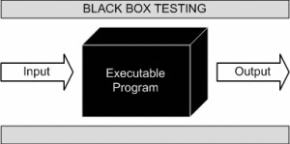
CHAPTER-7
Testing
Test Case – 1
Black-Box Testing
Black Box Testing, also known as Behavioural Testing, is a software testing method in which the internal structure/ design/ implementation of the item being tested is not known to the tester. These tests can be functional or non-functional, though usually functional.
This can be following way:
Input interfacing
Processing
Output interfacing
This method is named so because the software program, in the eyes of the tester, is like a black box; inside which one cannot see. This method attempts to find errors in the following categories:
Incorrect or missing functions
Interface errors
Errors in data structures or external database access
Behaviour or performance errors

Slide 47
7.2 Test Case – 2
White-Box Testing
White Box Testing ,also known as Clear Box Testing, Open Box Testing, Glass Box Testing, Transparent Box Testing, Code-Based Testing or Structural Testing is a software testing method in which the internal structure/ design/ implementation of the item being tested is known to the tester.
The tester chooses inputs to exercise paths through the code and determines the appropriate outputs.
Programming know-how and the implementation knowledge is essential.
White box testing is testing beyond the user interface and into the nitty-gritty of a system.
This method is named so because the software program, in the eyes of the tester, is like a white/ transparent
box; inside which one clearly sees.

Slide 48
CHAPTER 8
INPUT DATA AND VALIDATION OF THE PROJECT
All the fields such as Performer, Album Type, and Music are validated and do not take invalid values
Each form for Performer, Album, and User cannot accept blank value fields
Avoiding errors in data Controlling the amount of input
Integration of all the modules/forms in the system.
Preparation of the test cases.
Preparation of the possible test data with all the validation checks.
Actual testing is done manually.
Recording of all the reproduced errors.
Modifications are done for the errors found during testing.
Prepared the test result scripts after rectification of the errors.
Functionality of the entire module/forms.
Validations for user input.
Checking of the Coding standards to be maintained during coding.

Slide 49
CHAPTER 9
SOFTWARE REQUIREMENT SPECIFICATION
The Software Requirements Specification is produced at the culmination of the analysis task. The function and performance allocated to software as part of system engineering are refined by establishing a complete information description, a detailed functional and behavioural description, an indication of performance requirements and design constraints, appropriate validation criteria, and other data pertinent requirements.The proposed system has the following requirements:
. System needs to store information about the new entry of the Performer
. System needs to help the internal staff to keep informed of Album and find them as per various queries
. System needs to maintain quantity records.
. System needs to keep the record of Album Type.
. System needs to update and delete the record.
. System also needs a search area.

Slide 50
CHAPTER 10 IDENTIFICATION OF NEED
The old manual system was suffering from a series of drawbacks. Since the whole of the system was to be maintained with hands the process of keeping, maintaining, and retrieving the information was very tedious and lengthy. The records were never used to be in a systematic order. there used to be lots of difficulties in associating any particular transaction with a particular context. If any information was to be found it was required to go through the different registers, and documents there would never exist anything like report generation. There would always be unnecessary consumption of time while entering records and retrieving records. One more problem was that it was very difficult to find errors while entering the records. Once the records were entered it was very difficult to update these records.
The reason behind it is that there is a lot of information to be maintained and has to be kept in mind while running the business for this reason we have provided features Present system is partially automated (computerized), actually, the existing system is quite laborious as one has to enter same information at three different places.
The following points should be well considered:
. Documents and reports that must be provided by the new system: there can also be e few reports, which can help management in decision-making and cost control, but since these reports do not get t required attention, such kinds of reports and information were also identified and give the n required attention.
. Details of the information needed for each document and report.
. The required frequency and distribution for each document.
. Probable sources of information for each document and report.
. With the implementation of a computerized system, the task of keeping records in an organized manner will be solved. The greatest of all is the retrieval of information, which will be at the click of the mouse. So, the proposed system helps in saving time in different operations and making information flow easy giving valuable reports.

Slide 51
CHAPTER 11 SYSTEM DESIGN
In this phase, a logical system is built which fulfils the given requirements. The design phase of software development deals with transforming the clients’ requirements into a logically working system. Normally, design is performed in the following two steps:
11.1 Primary Design Phase:
In this phase, the system is designed at the block level. The blocks are created based on analysis done in the problem identification phase. Different blocks are created for different functions emphasis is put on minimizing the information flow between blocks. Thus, all activities which require more interaction are kept in one block.
Secondary Design Phase:
In the second phase, the detailed design of every block is performed.
The general tasks involved in the design process are the following:
Design various blocks for overall system processes.
Design smaller, compact and workable modules in each block
Design various database structures
Specify details of programs to achieve the desired functionality
Design the form of inputs, and outputs of the system.
Perform documentation of the design.
System reviews

Slide 52
CHAPTER 12
USER INTERFACE DESIGN
User Interface Design is concerned with the dialogue between a user and the computer. It is concerned with everything from starting the system or logging into the system to the eventual presentation of desired inputs and outputs. The overall flow of screens and messages is called dialogue.
The following steps are various guidelines for User Interface Design:
The system user should always be aware of what to do next.
The screen should be formatted so that various types of information, and instructions messages always appear in the same general display area.
Messages, instructions, or information should be displayed long enough to allow the system user to read them.
Use display attributes sparingly.
Default values for fields and answers to be entered by the user should be specified.
A user should not be allowed to proceed without correcting an error.
The system user should never get an operating system message or fatal error.

Slide 53
CHAPTER 13
PRELIMINARY PRODUCT DESCRIPTION
The first step in the system development life cycle is the preliminary investigation to determine the feasibility of the system. The purpose of the preliminary investigation is to evaluate project requests. It is not a design study nor does it include the collection of details to describe the business system in all respect. Rather, it is the collecting of information that helps committee members to evaluate the merits of the project request and make an informed judgment about the feasibility of the proposed project.
Analysts working on the preliminary investigation should accomplish the following objectives:
Clarify and understand the project request.
Determine the size of the project.
Assess the costs and benefits of alternative approaches.
Determine the technical and operational feasibility of alternative approaches.
Report the findings to management, with recommendations outlining the acceptance or rejection of the proposal

Slide 54
BIBILIOGRAPHY
Google
Stack overflow

